Slide 1
Data Structures
17. Tree Data Structure

Slide 2
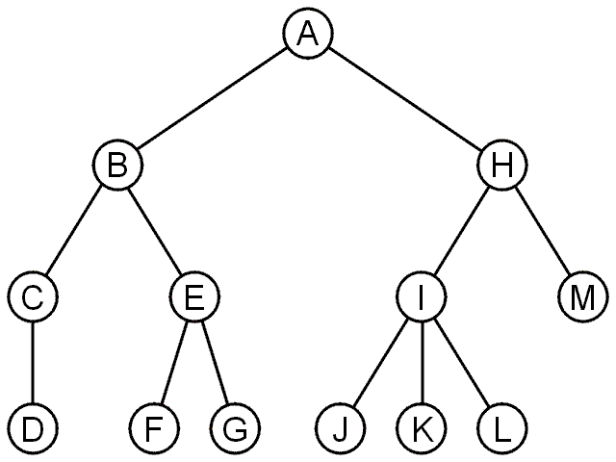
Trees
A rooted tree data structure stores information in nodes
Similar to linked lists:
There is a first node, or root
Each node has variable number of references to successors
Each node, other than the root, has exactly one node pointing to it

Slide 3
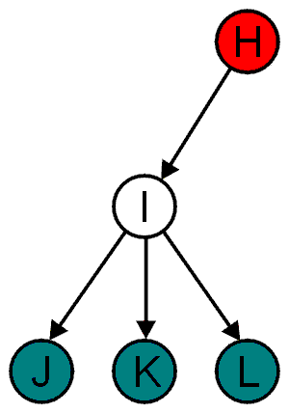
Terminology: Parent Child Relations
All nodes have zero or more child nodes or children
I has three children: J, K and L
For all nodes other than the root node, there is one parent node
H is the parent I

Slide 4
Terminology: Degree
The degree of a node is defined as the number of its children
deg(I) = 3
Nodes with the same parent are siblings
J, K, and L are siblings

Slide 5
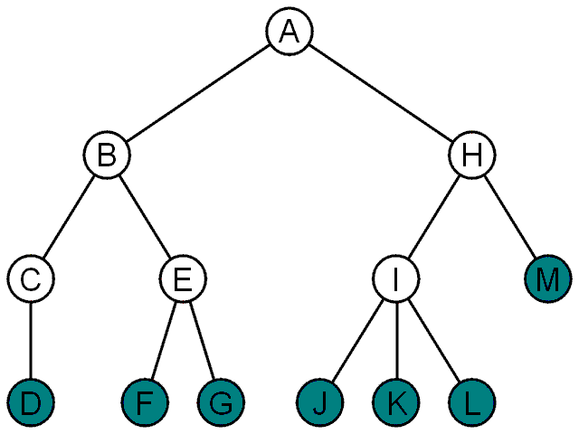
Terminology: Leaf And Internal Nodes
Nodes with degree zero are also called leaf nodes
All other nodes are said to be internal nodes, that is, they are internal to the tree

Slide 6
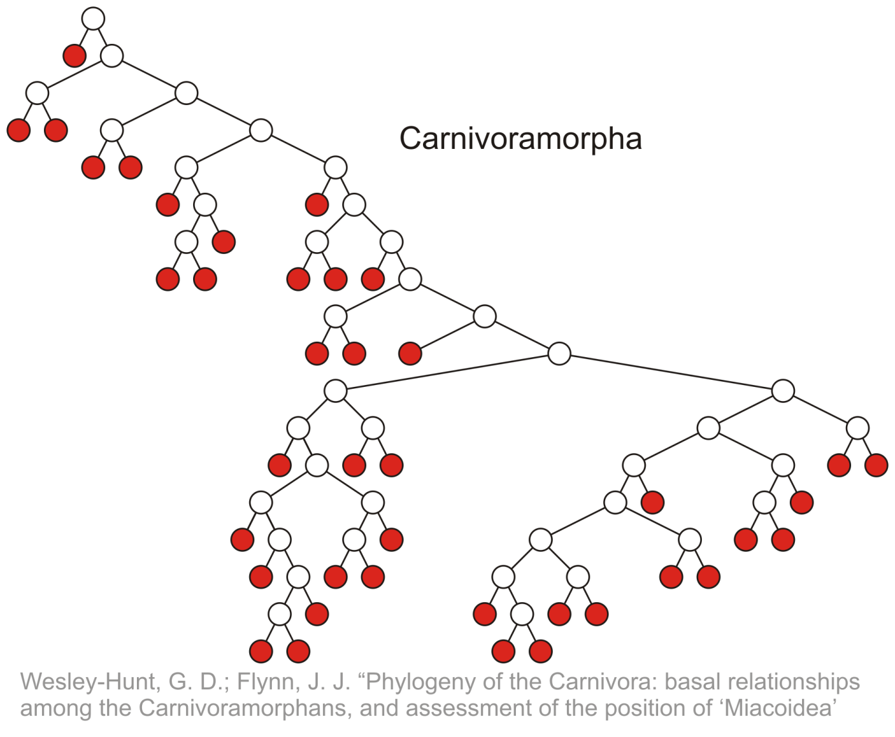
Terminology: Leaf Nodes Examples
Leaf nodes

Slide 7
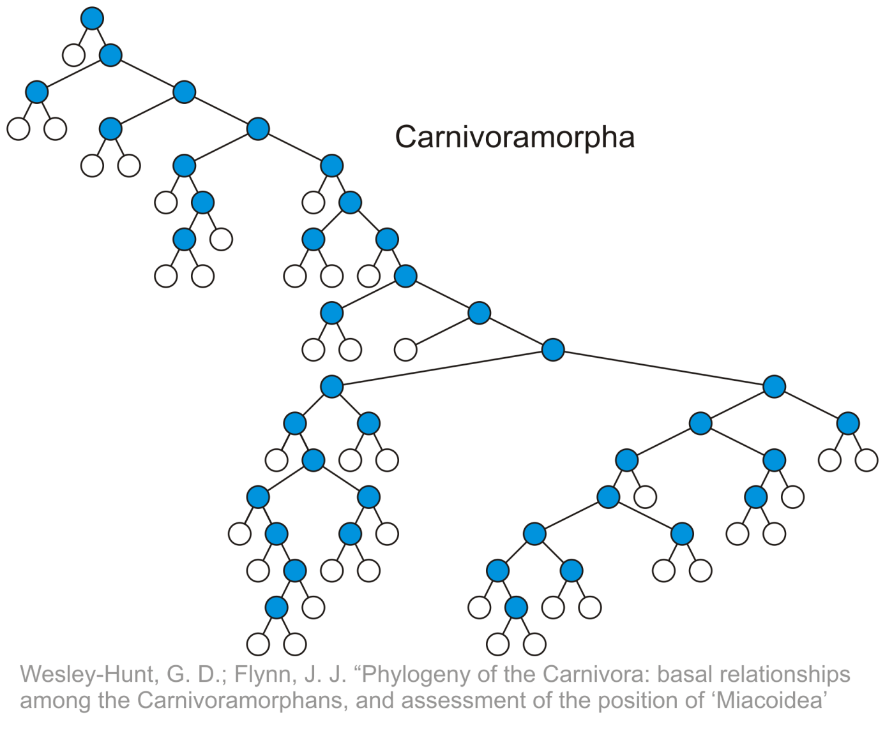
Terminology: Internal Nodes Example
Internal nodes

Slide 8
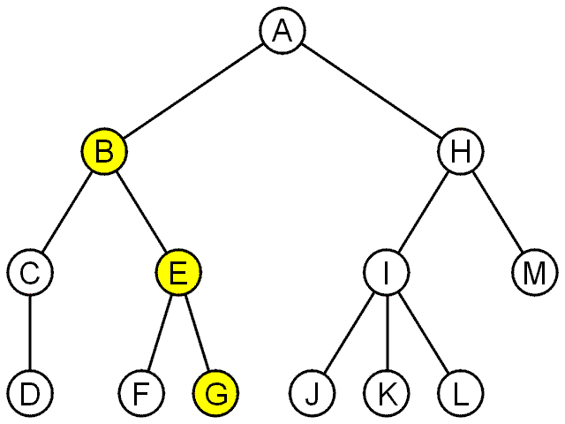
Terminology: Path
A path is a sequence of nodes (a₀, a₁, ..., a_{n})
Where a_{k} + 1 is a child of a_{k}
The length of this path is: n = |nodes in the path| - 1
For example, the path (B, E, G) has length 2

Slide 9
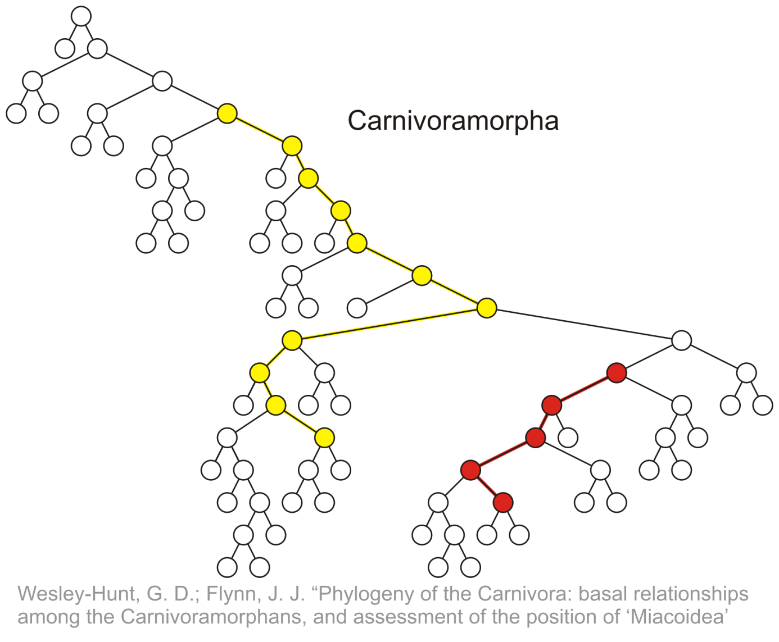
Terminology: Path Example
Paths of length 10 (11 nodes) and 4 (5 nodes)
Start of these paths
End of these paths

Slide 10
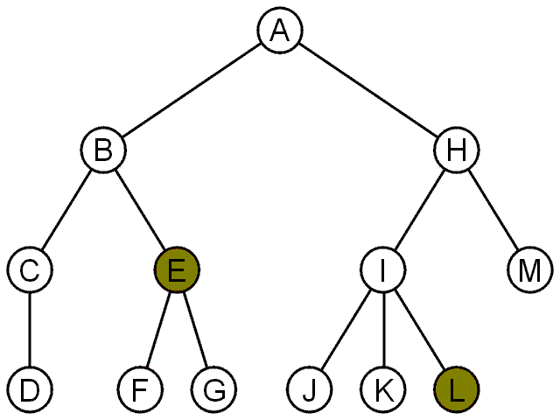
Terminology: Depth (or Level)
For each node in a tree, there exists a unique path from the root node to that node
The length of this path is the depth of the node, e.g.,
E has depth 2
L has depth 3

Slide 11
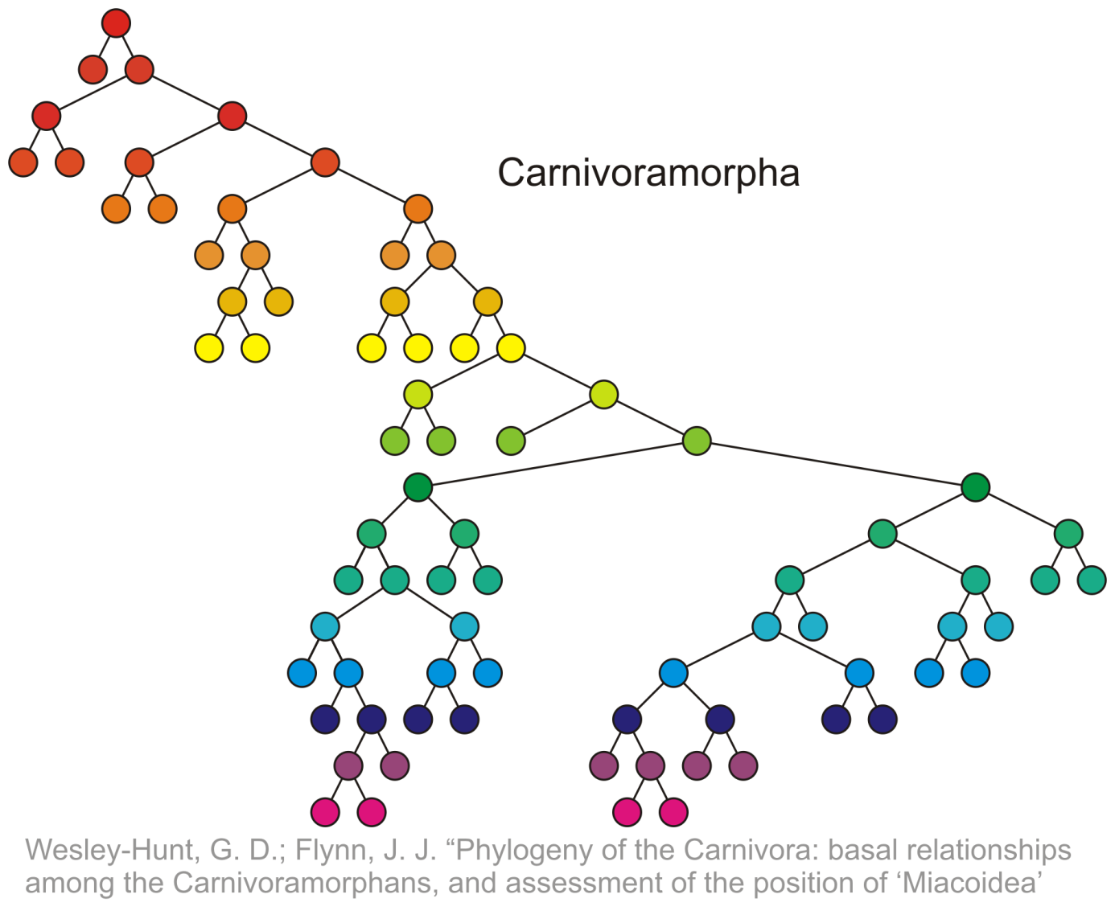
Terminology: Depth Example
Nodes of depth up to 17
0
4
9
14
17

Slide 12
Terminology: Height
The height of a tree is defined as the maximum depth of any node within the tree
The height of a tree with one node is 0
Just the root node
For convenience, we define the height of the empty tree to be –1

Slide 13
Terminology: Height Example
Height of this tree is 17
17

Slide 14
Terminology: Ancestors And Descendants
If a path exists from node a to node b
a is an ancestor of b
b is a descendent of a
Thus, a node is both an ancestor and a descendant of itself
We can add the adjective strict to exclude equality
a is a strict descendent of b if a is a descendant of b but a ≠ b
The root node is an ancestor of all nodes

Slide 15
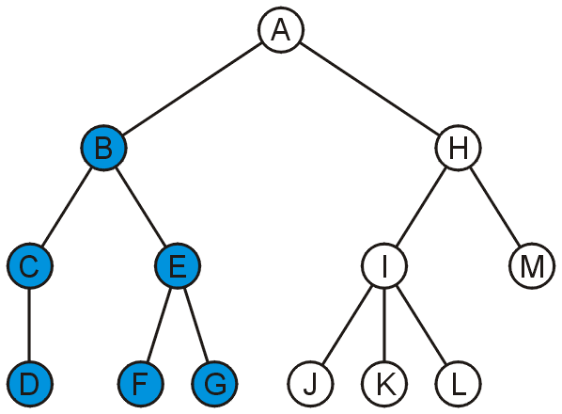
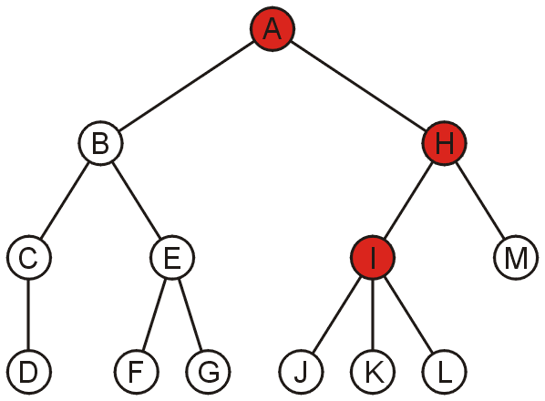
Terminology: Ancestors And Descendants Example
The descendants of node B are C, D, E, F, and G
The ancestors of node I are H and A

Slide 16
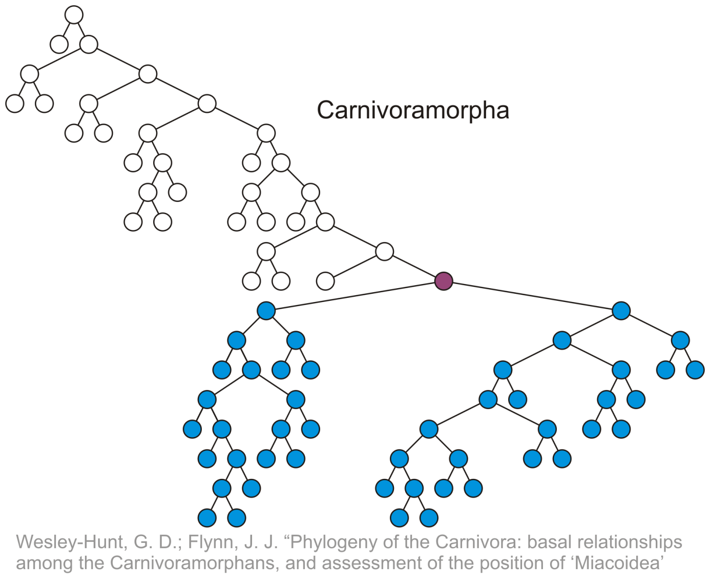
Terminology: Descendants Example
All descendants (including itself) of the indicated node

Slide 17
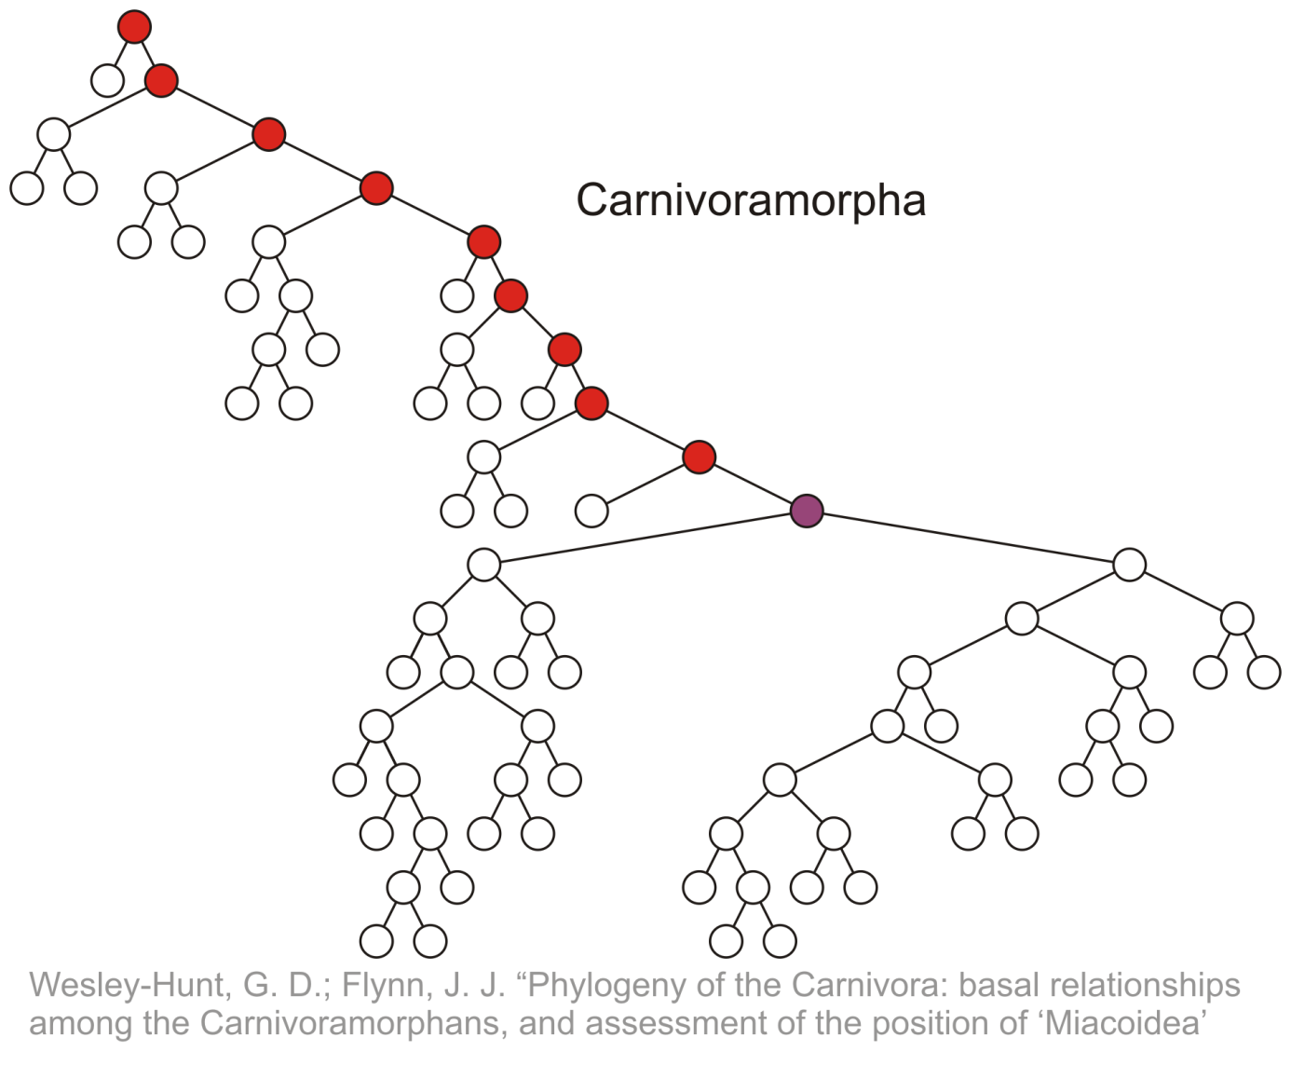
Terminology: Ancestors Example
All ancestors (including itself) of the indicated node

Slide 18
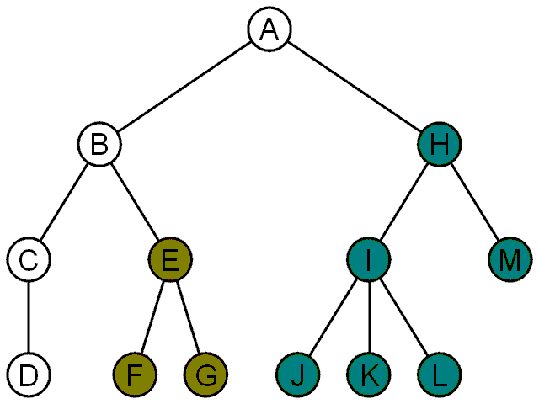
Terminology: Subtree
Another approach to a tree is to define the tree recursively
A degree-0 node is a tree
A node with degree n is a tree if it has n children
All of its children are disjoint trees (i.e., with no intersecting nodes)
Given any node a within a tree with root r, the collection of a and all of its descendants is said to be a subtree of the tree with root a

Slide 19
Tree Properties
A
Property Value
Number of nodes
Height
Root Node
Leaves
Ancestors of H
Descendants of B
Siblings of E
Left subtree
B
C
D
E
F
G
H
I

Slide 20
Example: HTML (1)
HTML document has a tree structure
<html>
<head>
<title>Hello World!</title>
</head>
<body>
<h1>This is a <u>Heading</u></h1>
<p>This is a paragraph with some
<u>underlined</u> text.</p>
</body>
</html>

Slide 21
Example: HTML (2)
HTML document has a tree structure
title
<html>
<head>
<title>Hello World!</title>
</head>
<body>
<h1>This is a <u>Heading</u></h1>
<p>This is a paragraph with some
<u>underlined</u> text.</p>
</body>
</html>
heading
body of page
paragraph
underlining

Slide 22
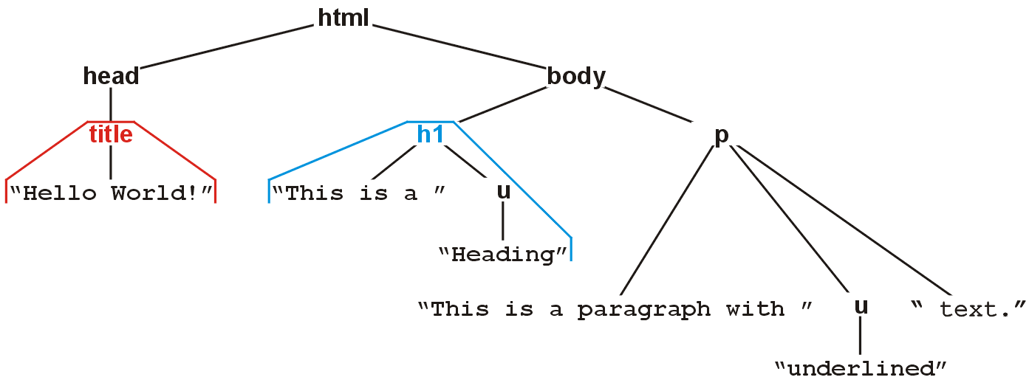
Example: HTML (3)
The nested tags define a tree rooted at the HTML tag
<html>
<head>
<title>Hello World!</title>
</head>
<body>
<h1>This is a <u>Heading</u></h1>
<p>This is a paragraph with some
<u>underlined</u> text.</p>
</body>
</html>

Slide 23
Binary Tree

Slide 24
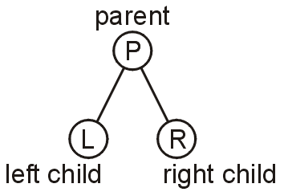
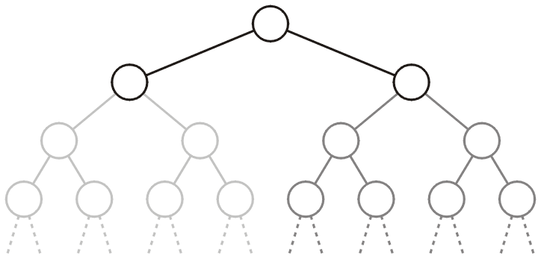
Binary Tree
In a binary tree each node has at most two children
Allows to label the children as left and right
Likewise, the two sub-trees are referred as
Left-hand subtree
Right-hand subtree

Slide 25
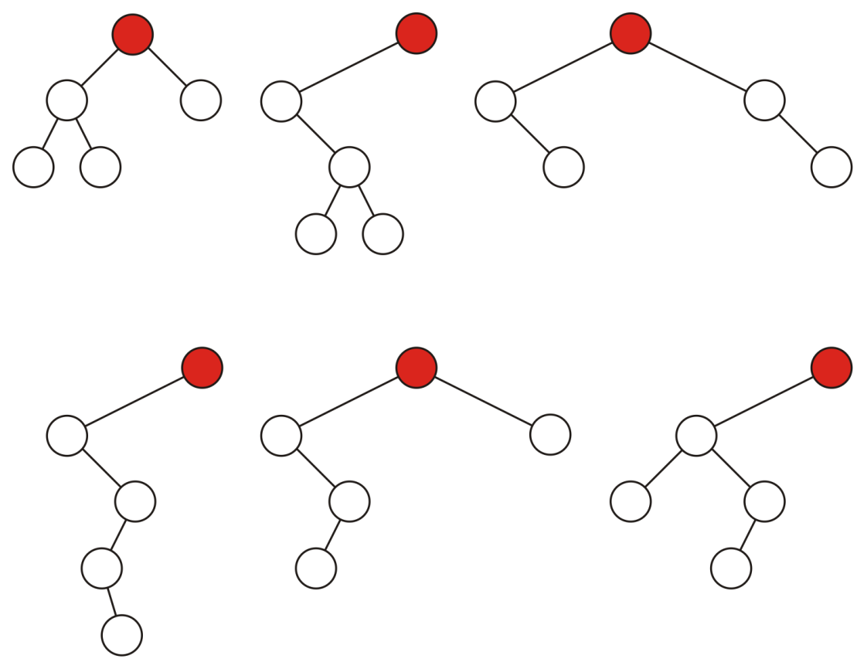
Binary Tree: Example
Some variations on binary trees with five nodes

Slide 26
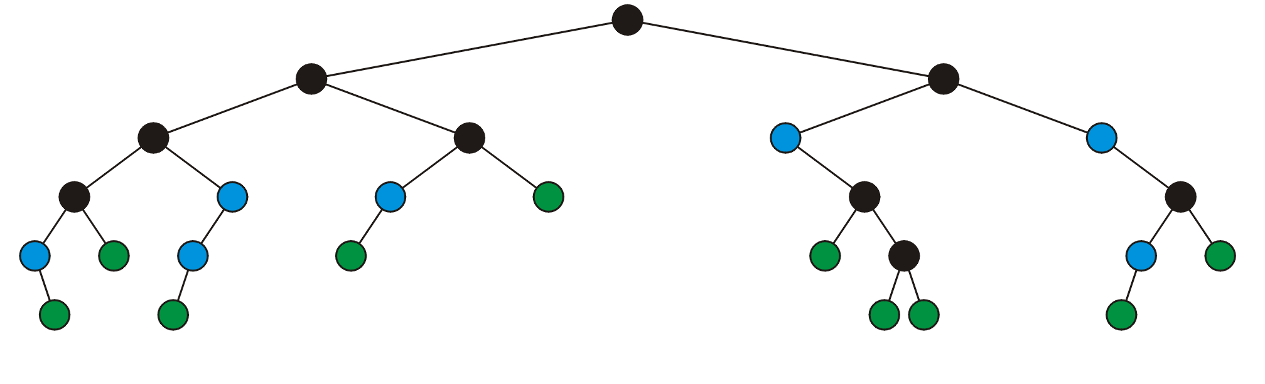
Binary Tree: Full Node
A full node is a node where both the left and right sub-trees are non-empty trees
full nodes neither leaf nodes

Slide 27
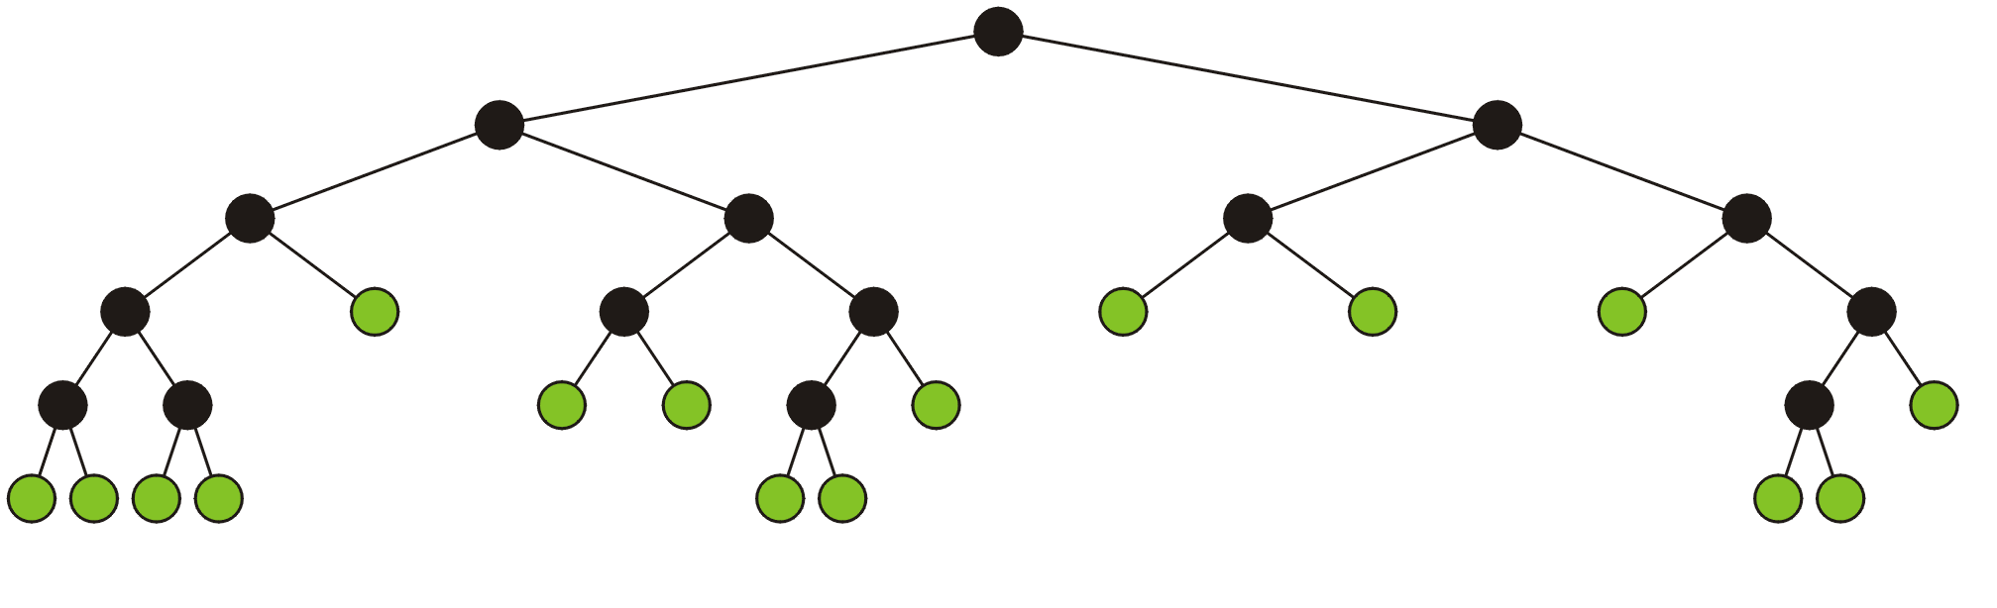
Full Binary Tree
A full binary tree is where each node is:
A full node, or
A leaf node
Full binary tree is also called proper binary tree, strictly binary tree or 2-tree

Slide 28
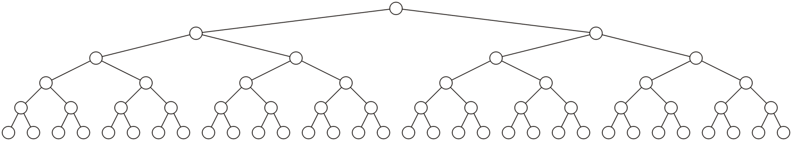
Complete (Or Perfect) Binary Tree
A complete binary tree of height h is a binary tree where
All leaf nodes have the same depth h
All other nodes are full

Slide 29
Complete Binary Tree: Recursive Definition
A binary tree of height h = 0 is perfect
A binary tree with height h > 0 is perfect
If both sub-trees are prefect binary trees of height h – 1

Slide 30
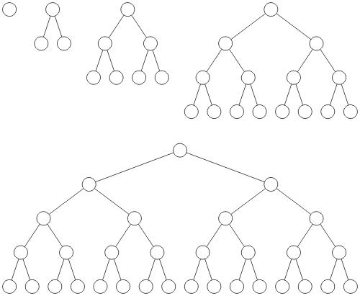
Complete Binary Tree: Example
Complete binary trees of height h = 0, 1, 2, 3 and 4

Slide 31
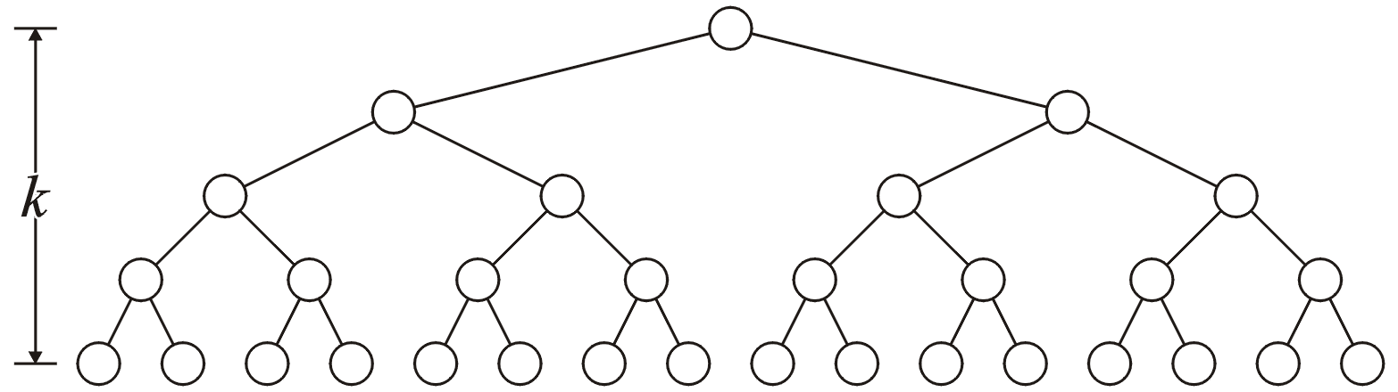
Binary Tree: Properties (1)
A complete binary tree with height h has 2^{h} leaf nodes
h

Slide 32
Binary Tree: Properties (2)
A complete binary tree with height h has 2^{h} leaf nodes
A complete binary tree of height h has 2^{h + 1} – 1 nodes
h

Slide 33
Binary Tree: Properties (3)
A complete binary tree with height h has 2^{h} leaf nodes
A complete binary tree of height h has 2^{h + 1} – 1 nodes
Number of leaf nodes: L = 2^{h}
Number of internal nodes: 2^{h} – 1
Total number of nodes: 2L-1 = 2^{h + 1} – 1
h

Slide 34
Binary Tree: Properties (4)
A complete binary tree with height h has 2^{h} leaf nodes
A complete binary tree of height h has 2^{h + 1} – 1 nodes
Number of leaf nodes: L = 2^{h}
Number of internal nodes: 2^{h} – 1
Total number of nodes: 2L-1 = 2^{h + 1} – 1
A complete binary tree with n nodes has height log₂(n + 1) – 1

Slide 35
Binary Tree: Properties (4)
A complete binary tree with height h has 2^{h} leaf nodes
A complete binary tree of height h has 2^{h + 1} – 1 nodes
Number of leaf nodes: L = 2^{h}
Number of internal nodes: 2^{h} – 1
Total number of nodes: 2L-1 = 2^{h + 1} – 1
A complete binary tree with n nodes has height log₂(n + 1) – 1
Number n of nodes in a binary tree of height h is at least h+1 and at most 2^{h + 1} – 1

Slide 36
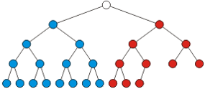
Almost (or Nearly) Complete Binary Tree
Almost complete binary tree of height h is a binary tree in which
There are 2^{d} nodes at depth d for d = 1,2,...,h−1
Each leaf in the tree is either at level h or at level h– 1
The nodes at depth h are as far left as possible
Complete binary tree of height h-1
Missing node towards the right

Slide 37
Almost (or Nearly) Complete Binary Tree
Almost complete binary tree of height h is a binary tree in which
There are 2^{d} nodes at depth d for d = 1,2,...,h−1
Each leaf in the tree is either at level h or at level h– 1
The nodes at depth h are as far left as possible (Formal ?)
Complete binary tree of height h-1
Missing node towards the right

Slide 38
Almost (or Nearly) Complete Binary Tree
Condition 2: The nodes at depth h are as far left as possible
If a node p at depth h−1 has a left child
Every node at depth h−1 to the left of p has 2 children
If a node at depth h−1 has a right child
It also has a left child
Almost Complete binary tree
Not Almost Complete binary tree
(condition 2 violated)

Slide 39
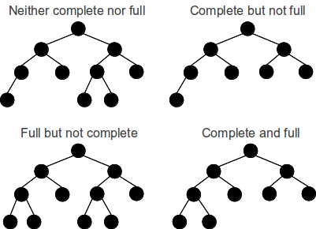
Full vs. Almost Complete Binary Tree

Slide 40
Almost Complete Binary Tree: Properties
Total number of nodes n are between
Complete binary tree of height h-1, i.e., 2^{h} nodes
Complete binary tree of height h, i.e., 2^{h+1} -1 nodes
Height h is the largest integer less than or equal to log₂(n)

Slide 41
(Completely) Balanced Binary Tree
Balanced binary tree
For each node, the difference in height of the right and left sub-trees is no more than one
Completely balance binary tree
Left and right sub-trees of every node have the same height

Slide 42
Balanced Binary Tree: Example
a
a
b
c
b
c
e
d
e
f
g
d
f
h
i
j
g
h
A balanced binary tree
i
j
An unbalanced binary tree

Slide 43
Any Question So Far?

Slide 44
(Completely) Balanced Binary Tree
Balanced binary tree
For each node, the difference in height of the right and left sub-trees is no more than one
When a binary tree is balanced?
If every level above the lowest is “complete”
Completely balance binary tree
Left and right sub-trees of every node have the same height

Slide 45
Complete (or Perfect) Binary Tree: Definitions
A complete binary tree with height h has 2^{h} leaf nodes
A complete binary tree of height h has 2^{h + 1} – 1 nodes
Number of leaf nodes: 2^{h}
Number of internal nodes: 2^{h} - 1
A complete binary tree with n nodes has height log₂(n + 1) – 1
h

Slide 46
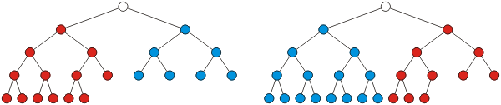
Almost Complete Binary Tree
A binary tree of height h is an almost complete binary tree if:
Any node a at depth (or level) less than h-1 has two children
For any node a in the tree with a right descendant at level h,
a must have a left child
Every left child of a is either a leaf at level h or has two children

